Slide 1




Manufacturing Project

Slide 2




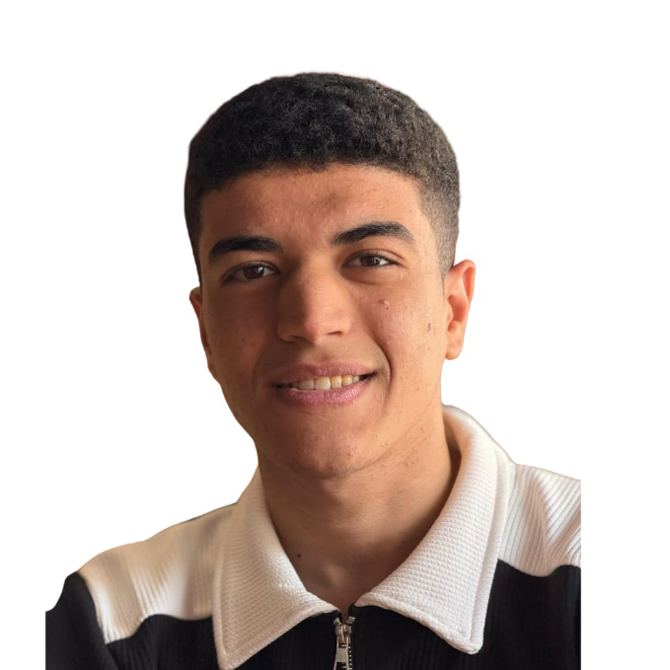







Project Team
Mohamed Emad
Menna Younes
Mohamed Elsayed
Farah Magdy
Mohamed Ahmed

Slide 3
Manufacturing Project
Project Time Line

Slide 4
Problem Definition
Data Acquisition
Data Cleaning
Project Time Line
Data Modeling
DAX Calculations
Exploratory Analysis
Visualization

Slide 5
1. Project Objective
To analyze the alignment between administrative planning and shop-floor operations to identify production bottlenecks and optimize resource utilization.
2. Business Questions
How does the actual production output compare to the administrative targets?
What are the main causes of machine downtime or operational delays?
Which production lines show the highest efficiency and which need maintenance?
3. Key Performance Indicators – KPIs
OEE (Overall Equipment Effectiveness):
Production Yield:
Downtime Rate:
Cycle Time:
4. Target Audience
Operations Managers
Production Supervisors
Supply Chain & Administrative Planners
Problem Definition

Slide 6
.1Administrative Data (Internal):
Consists of organizational data from the initiative, including production
targets, employee shifts, and resource schedules.
.2Operational Data (External):
Sourced from Kaggle, consisting of real-time machine performance, sensor readings (temperature/pressure), and actual production output.
.3Method:
Data was extracted and imported into Power BI using Power Query to integrate internal administrative files with external operational datasets.
Data Acquisition

Slide 7
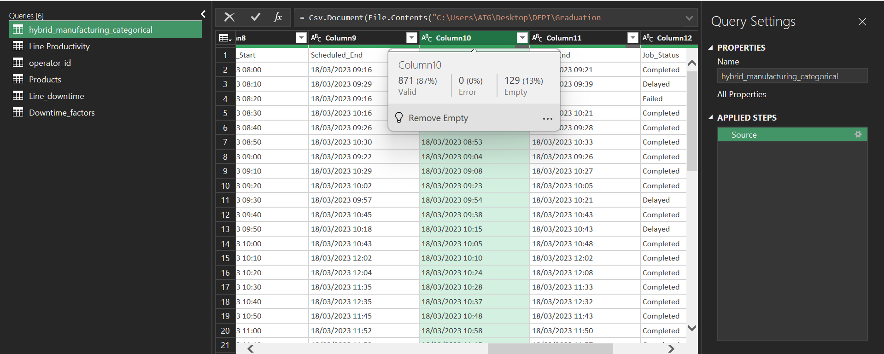
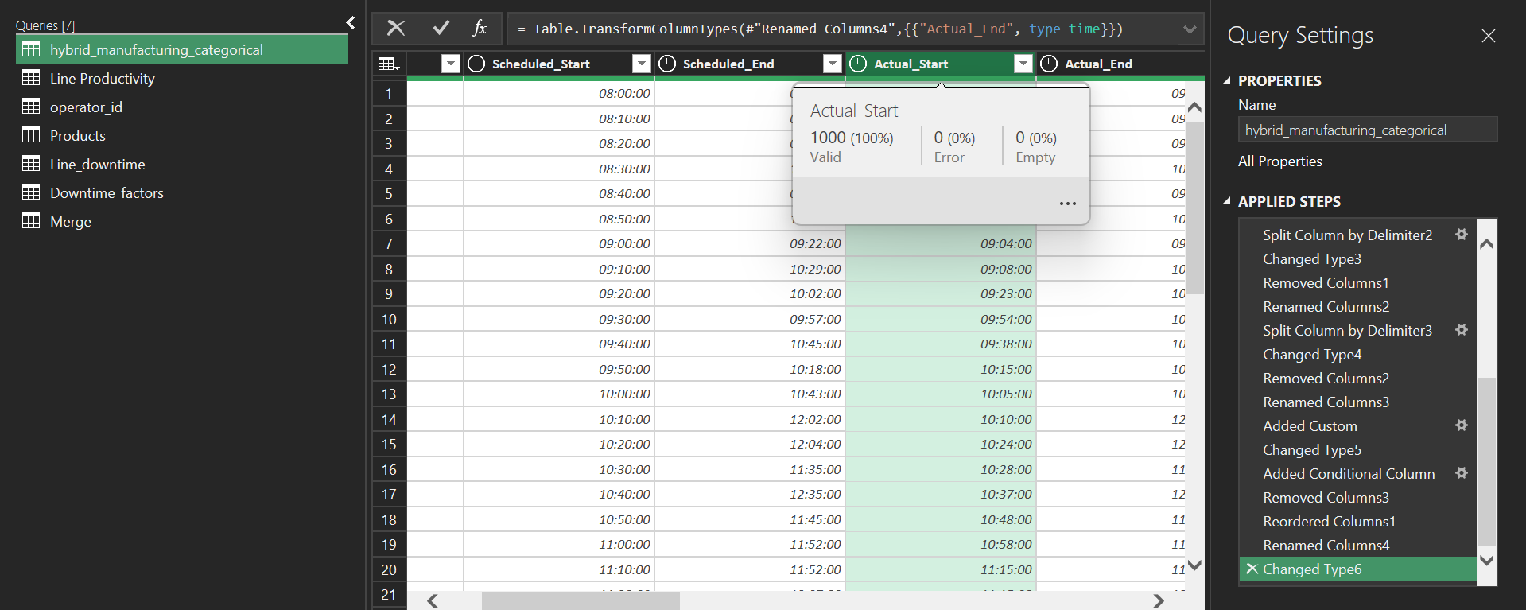
Data Cleaning
Before
After

Slide 8
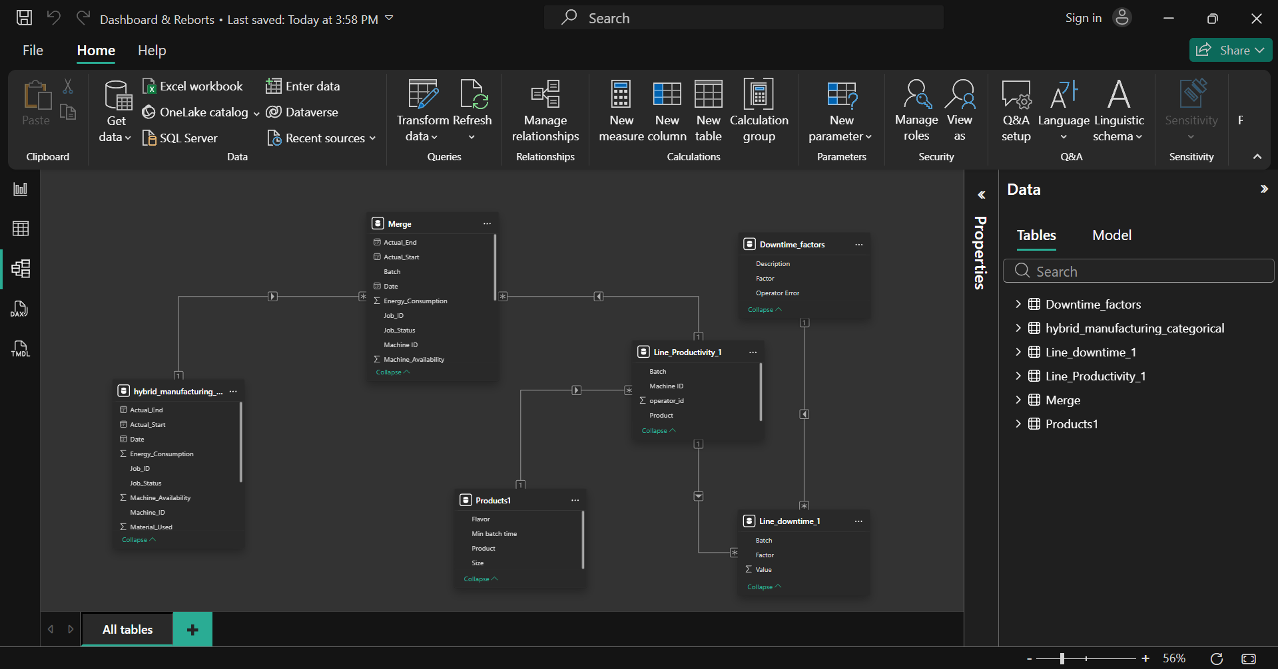
Data Modeling

Slide 9

Thanks for your time :)

Slide 10
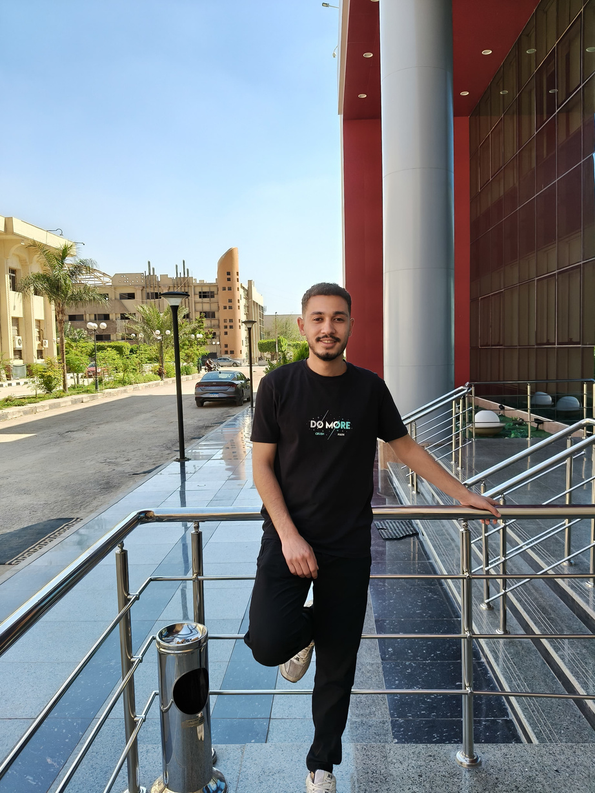





Project Team + Roles
Mohamed Emad
Introduction
I’m Mohamed Emad, a 20-year-old student at Al-Azhar University’s Faculty of Agriculture. Passionate about analytical thinking and leveraging technology to solve complex problems. Currently exploring innovative ways to bridge data-driven insights with real-world applications in the agricultural field.
Team Leader
Data Insights Specialist
– Data analysis and insights generation
– Supporting the team in extracting and refining final insights
– Data analysis using Excel (Pivot Tables + Charts)

Slide 11

Project Team + Roles
Menna Younes
Introduction
I am a third-year MIS student at Helwan University (English Section). I specialize in integrating technology with business strategies. My focus is on optimizing operational efficiency through digital transformation and providing actionable, data-driven insights to enhance decision-making..
Role
Data Insights Specialist
– Data analysis and insights generation
– Supporting the team in extracting and refining final insights
– Data analysis using Excel (Pivot Tables + Charts)

Slide 12
Project Team + Roles
Mohamed Elsayed
Introduction
Mohamed Elsayed Mohamed, is a 23-year-old, a Telecommunications & Electronics Engineering student passionate about Data Analytics. Skilled in the full data lifecycle including data cleaning, modeling, and building professional dashboards using Excel and Power BI to turn raw data into actionable insights.
Role
Data Insights Specialist
– Data analysis and insights generation
– Supporting the team in extracting and refining final insights
– Data analysis using Excel (Pivot Tables + Charts)

Slide 13
Project Team + Roles
Farah Magdy
Introduction
Farah Magdy A 19 years old student at Cairo University and Georgia State University joint program. Specializing in Data Analysis and Marketing, I am passionate about transforming raw data into actionable business insights and creative branding strategies. I am dedicated to continuous technical growth and professional excellence.
Role
Data Insights Specialist
– Data analysis and insights generation
– Supporting the team in extracting and refining final insights
– Data analysis using Excel (Pivot Tables + Charts)

Slide 14
Project Team + Roles
Mohamed Ahmed
Introduction
Mohamed Ahmed Abubakr, l’m 20 years old. Intelligent Systems Engineering student at Helwan National University (HNU) specializing in Data Analytics and Business Intelligence. Experienced in analyzing complex datasets and transforming them into clear, interactive visualizations using Power BI and Excel, enabling better understanding of data, uncovering hidden insights, and supporting strategic decision.
Data Insights Specialist
– Data analysis and insights generation
– Supporting the team in extracting and refining final insights
– Data analysis using Excel (Pivot Tables + Charts)

